Slide 1
Linear algebra for machine learning
Week2

Slide 2
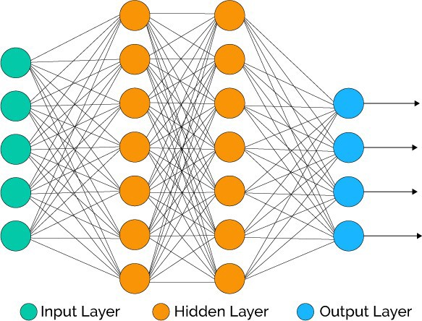
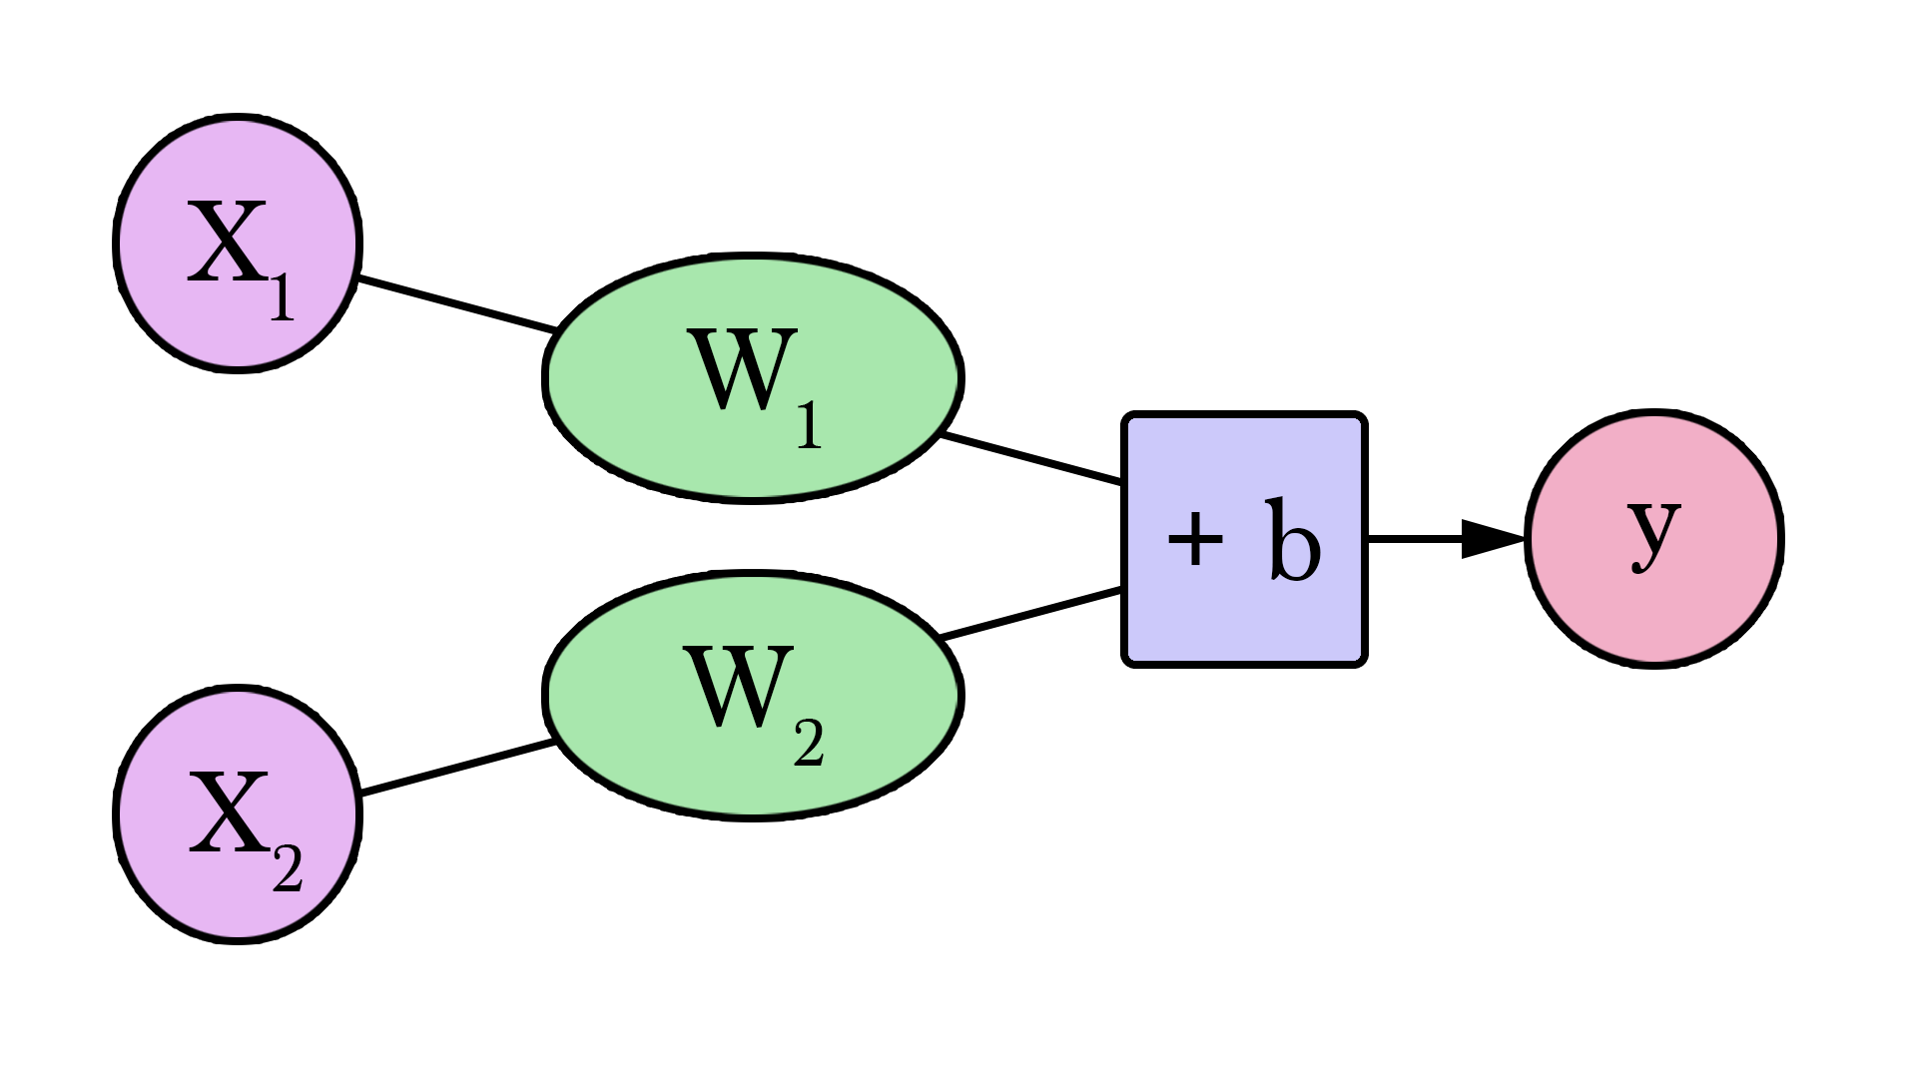

Linear algebra and machine learning
$$X_{1}W_{1 }+X_{2}W_{2 }+b_{1 }=y$$

Slide 3
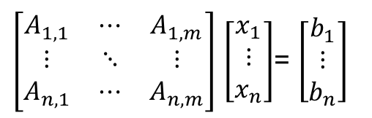
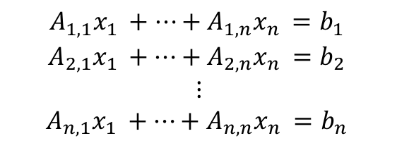
Linear Algebra and machine learning
Machine learning is optimizing the network (system of equations) and
find the sensitivity of the system for each feature (The change in output with change in each feature of input.
$$\begin{matrix}A_{1,1}x_{1 }+⋯+A_{1,n}x_{n }=b_{1 } \\ A_{2,1}x_{1 }+⋯+A_{2,n}x_{n }=b_{2 } \\ \begin{aligned}⋮ \\ A_{n,1}x_{1 }+⋯+A_{n,n}x_{n }=b_{n }\end{aligned}\end{matrix}$$
$\left[\begin{matrix}A_{1,1} & ⋯ & A_{1,m} \\ ⋮ & ⋱ & ⋮ \\ A_{n,1} & ⋯ & A_{n,m}\end{matrix}\right]$ $\left[\begin{matrix}x_{1} \\ ⋮ \\ x_{n}\end{matrix}\right]$= $\left[\begin{matrix}b_{1} \\ ⋮ \\ b_{n}\end{matrix}\right]$

Slide 4

Vectors
Vector is a 1-D array:
$$Y_{n×1}=\left[\begin{matrix}Y_{1} \\ ⋮ \\ Y_{n}\end{matrix}\right]$$
$$\left\{Y_{i}\right\} Y∈ℛ^{n}$$
Vector Express a magnitude and a direction;
Magnitude
Direction

Slide 5

Matrix
Assume the 2D variable vectors with elements indicated as $Y_{n×m}$
$$Y=\left[\begin{matrix}Y_{1,1} & ⋯ & Y_{1,m} \\ ⋮ & ⋱ & ⋮ \\ Y_{n,1} & ⋯ & Y_{n,m}\end{matrix}\right]$$
$\left\{Y_{ij}\right\} i$ is the row and j is the column and $Y∈ℛ^{n×m}$

Slide 6
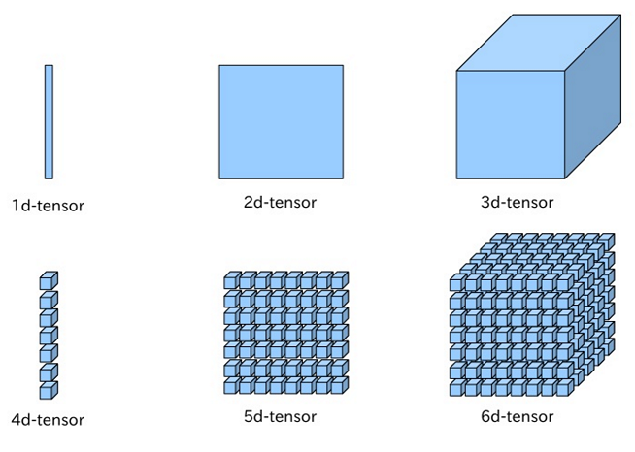

Tensor
Tensor is a n-D array
where n>2.
For example for 3-D tensor
we have $\left\{Y_{ijk}\right\}$
$i$ is the row
j is the column
$$Y∈ℛ^{n×m×k}$$

Slide 7
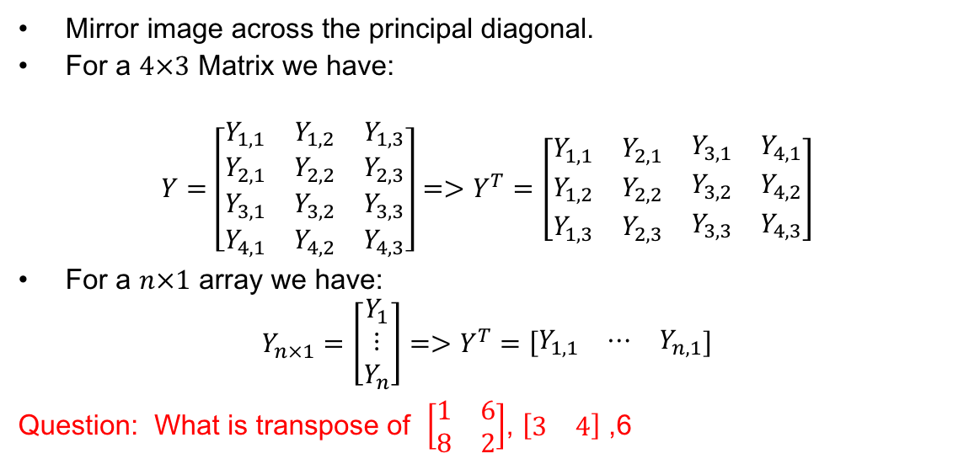
Matrix/Vector Transpose
Mirror image across the principal diagonal.
For a $4×3$ Matrix we have:
$$Y=\left[\begin{matrix}Y_{1,1} & Y_{1,2} & Y_{1,3} \\ Y_{2,1} & Y_{2,2} & Y_{2,3} \\ \begin{matrix}Y_{3,1} \\ Y_{4,1}\end{matrix} & \begin{matrix}Y_{3,2} \\ Y_{4,2}\end{matrix} & \begin{matrix}Y_{3,3} \\ Y_{4,3}\end{matrix}\end{matrix}\right]=>Y^{T}=\left[\begin{matrix}Y_{1,1} & Y_{2,1} & \begin{matrix}Y_{3,1} & Y_{4,1}\end{matrix} \\ Y_{1,2} & Y_{2,2} & \begin{matrix}Y_{3,2} & Y_{4,2}\end{matrix} \\ Y_{1,3} & Y_{2,3} & \begin{matrix}Y_{3,3} & Y_{4,3}\end{matrix}\end{matrix}\right]$$
For a $n×1$ array we have:
$$Y_{n×1}=\left[\begin{matrix}Y_{1} \\ ⋮ \\ Y_{n}\end{matrix}\right]=>Y^{T}=\left[\begin{matrix}Y_{1,1} & ⋯ & Y_{n,1}\end{matrix}\right]$$
Question: What is transpose of $\left[\begin{matrix}1 & 6 \\ 8 & 2\end{matrix}\right]$, $\left[\begin{matrix}3 & 4\end{matrix}\right]$ ,6

Slide 8
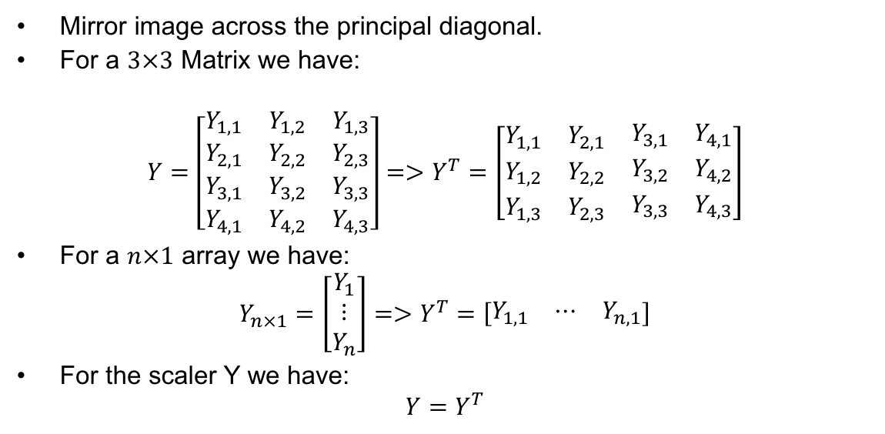
Matrix/Vector Transpose
Mirror image across the principal diagonal.
For a $3×3$ Matrix we have:
$$Y=\left[\begin{matrix}Y_{1,1} & Y_{1,2} & Y_{1,3} \\ Y_{2,1} & Y_{2,2} & Y_{2,3} \\ \begin{matrix}Y_{3,1} \\ Y_{4,1}\end{matrix} & \begin{matrix}Y_{3,2} \\ Y_{4,2}\end{matrix} & \begin{matrix}Y_{3,3} \\ Y_{4,3}\end{matrix}\end{matrix}\right]=>Y^{T}=\left[\begin{matrix}Y_{1,1} & Y_{2,1} & \begin{matrix}Y_{3,1} & Y_{4,1}\end{matrix} \\ Y_{1,2} & Y_{2,2} & \begin{matrix}Y_{3,2} & Y_{4,2}\end{matrix} \\ Y_{1,3} & Y_{2,3} & \begin{matrix}Y_{3,3} & Y_{4,3}\end{matrix}\end{matrix}\right]$$
For a $n×1$ array we have:
$$Y_{n×1}=\left[\begin{matrix}Y_{1} \\ ⋮ \\ Y_{n}\end{matrix}\right]=>Y^{T}=\left[\begin{matrix}Y_{1,1} & ⋯ & Y_{n,1}\end{matrix}\right]$$
For the scaler Y we have:
$$Y=Y^{T}$$

Slide 9
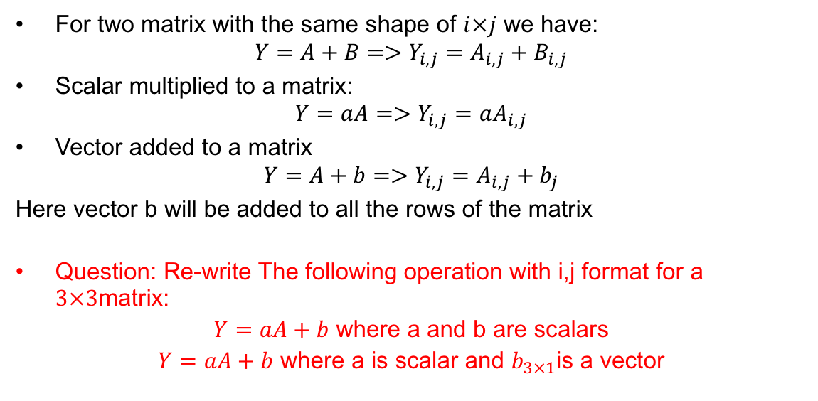
Matrix/Vector operation
For two matrix with the same shape of $i×j$ we have:
$$Y=A+B=>Y_{i,j}=A_{i,j}+B_{i,j}$$
Scalar multiplied to a matrix:
$$Y=aA=>Y_{i,j}=aA_{i,j}$$
Vector added to a matrix
$$Y=A+b=>Y_{i,j}=A_{i,j}+b_{j}$$
Here vector b will be added to all the rows of the matrix
Question: Re-write The following operation with i,j format for a $3×3$matrix:
$Y=aA+b$ where a and b are scalars
$Y=aA+b$ where a is scalar and $b_{3×1}$is a vector

Slide 10
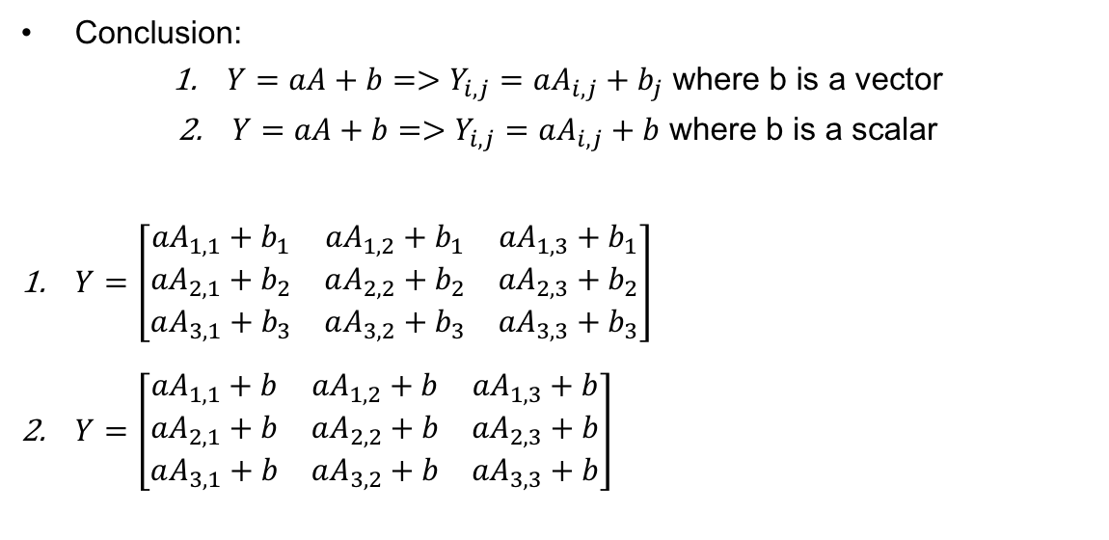
Matrix/Vector operation
Conclusion:
$Y=aA+b=>Y_{i,j}=aA_{i,j}+b_{j}$ where b is a vector
$Y=aA+b=>Y_{i,j}=aA_{i,j}+b$ where b is a scalar
$Y=\left[\begin{matrix}{aA}_{1,1}+b_{1} & {aA}_{1,2}+b_{1} & {aA}_{1,3}+b_{1} \\ {aA}_{2,1}+b_{2} & aA_{2,2}+b_{2} & {aA}_{2,3}+b_{2} \\ aA_{3,1}+b_{3} & aA_{3,2}+b_{3} & {aA}_{3,3}+b_{3}\end{matrix}\right]$
$Y=\left[\begin{matrix}{aA}_{1,1}+b & {aA}_{1,2}+b & {aA}_{1,3}+b \\ {aA}_{2,1}+b & aA_{2,2}+b & {aA}_{2,3}+b \\ aA_{3,1}+b & aA_{3,2}+b & {aA}_{3,3}+b\end{matrix}\right]$

Slide 11
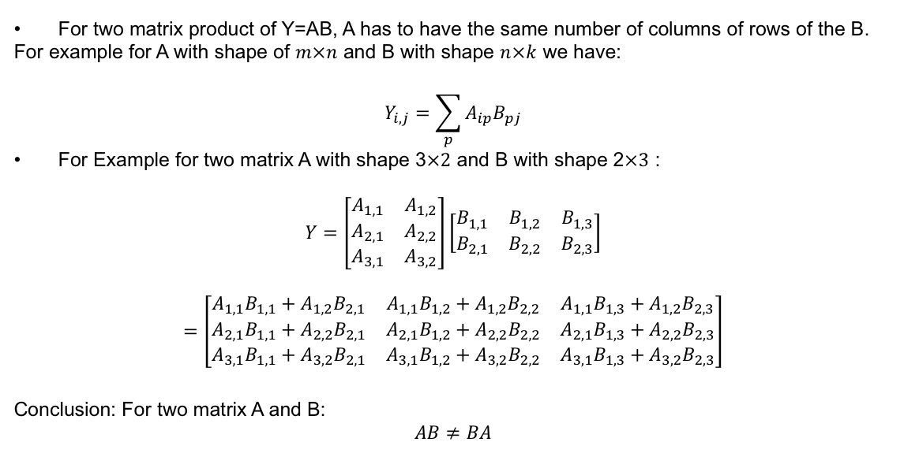
Matrix/Vector operation
For two matrix product of Y=AB, A has to have the same number of columns of rows of the B.
For example for A with shape of $m×n$ and B with shape $n×k$ we have:
$$Y_{i,j}=\sum_{p}{A_{ip}B_{pj}}$$
For Example for two matrix A with shape 3$×2$ and B with shape 2$×3$ :
$$Y=\left[\begin{matrix}A_{1,1} & A_{1,2} \\ \begin{aligned}A_{2,1} \\ A_{3,1}\end{aligned} & \begin{aligned}A_{2,2} \\ A_{3,2}\end{aligned}\end{matrix}\right]\left[\begin{matrix}B_{1,1} & B_{1,2} & B_{1,3} \\ B_{2,1} & B_{2,2} & B_{2,3}\end{matrix}\right]$$
$$=\left[\begin{matrix}A_{1,1}B_{1,1}+A_{1,2}B_{2,1} & A_{1,1}B_{1,2}+A_{1,2}B_{2,2} & A_{1,1}B_{1,3}+A_{1,2}B_{2,3} \\ A_{2,1}B_{1,1}+A_{2,2}B_{2,1} & A_{2,1}B_{1,2}+A_{2,2}B_{2,2} & A_{2,1}B_{1,3}+A_{2,2}B_{2,3} \\ A_{3,1}B_{1,1}+A_{3,2}B_{2,1} & A_{3,1}B_{1,2}+A_{3,2}B_{2,2} & A_{3,1}B_{1,3}+A_{3,2}B_{2,3}\end{matrix}\right]$$
Conclusion: For two matrix A and B:
$$AB≠BA$$
Sum product

Slide 12

Matrix/Vector operation
Assume vector Y as bellow, product $YY^{T}$ and $Y^{T}Y$ :
$$Y=\left[\begin{matrix}Y_{1,1} \\ Y_{2,1} \\ Y_{3,1}\end{matrix}\right]$$

Slide 13
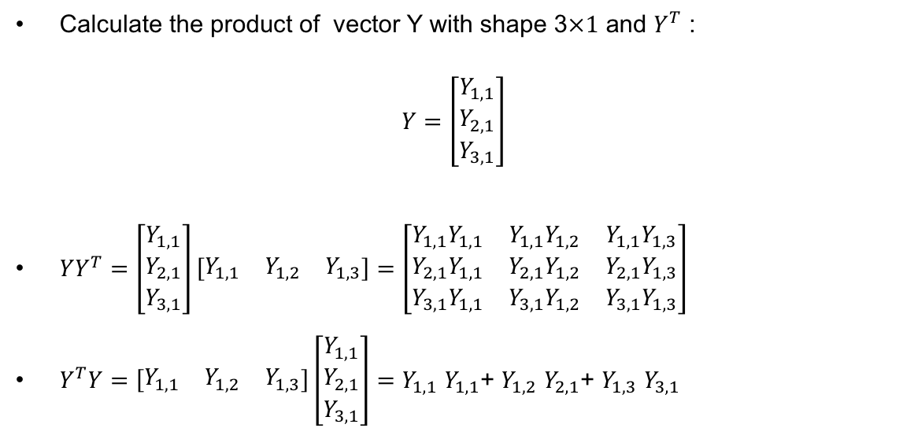
Matrix/Vector operation
Calculate the product of vector Y with shape 3$×1$ and $Y^{T}$ :
$$Y=\left[\begin{matrix}Y_{1,1} \\ Y_{2,1} \\ Y_{3,1}\end{matrix}\right]$$
$YY^{T}=\left[\begin{matrix}Y_{1,1} \\ Y_{2,1} \\ Y_{3,1}\end{matrix}\right]\left[\begin{matrix}Y_{1,1} & Y_{1,2} & Y_{1,3}\end{matrix}\right]=\left[\begin{matrix}Y_{1,1}Y_{1,1} & Y_{1,1}Y_{1,2} & {Y_{1,1}Y}_{1,3} \\ Y_{2,1}Y_{1,1} & Y_{2,1}Y_{1,2} & Y_{2,1}Y_{1,3} \\ Y_{3,1}Y_{1,1} & Y_{3,1}Y_{1,2} & Y_{3,1}Y_{1,3}\end{matrix}\right]$
$Y^{T}Y=\left[\begin{matrix}Y_{1,1} & Y_{1,2} & Y_{1,3}\end{matrix}\right]\left[\begin{matrix}Y_{1,1} \\ Y_{2,1} \\ Y_{3,1}\end{matrix}\right]=Y_{1,1}$ $Y_{1,1}$+ $Y_{1,2}$ $Y_{2,1}$+ $Y_{1,3}$ $Y_{3,1}$

Slide 14

Matrix operation Properties
Distributivity
$$A\left(B+C\right)=AB+AC$$
Associativity
$$A\left(BC\right)=(AB) C$$
Transpose of matrix product
$${(AB)}^{T}=B^{T}A^{T}$$

Slide 15
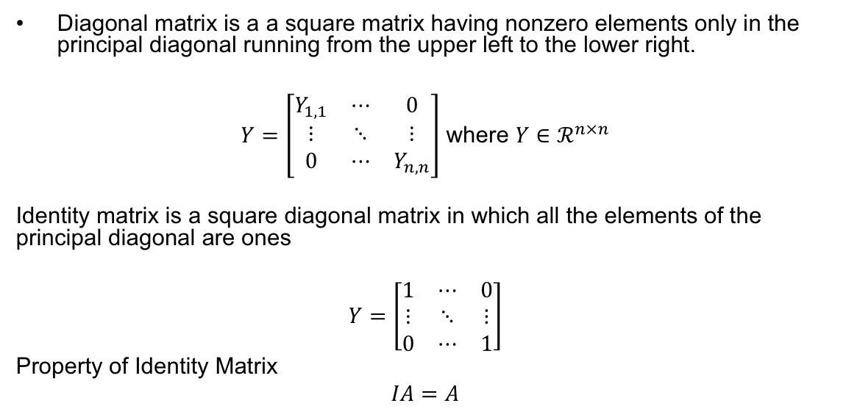
Diagonal Matrix
Diagonal matrix is a a square matrix having nonzero elements only in the principal diagonal running from the upper left to the lower right.
$Y=\left[\begin{matrix}Y_{1,1} & ⋯ & 0 \\ ⋮ & ⋱ & ⋮ \\ 0 & ⋯ & Y_{n,n}\end{matrix}\right]$ where $Y∈ℛ^{n×n}$
Identity matrix is a square diagonal matrix in which all the elements of the principal diagonal are ones
$$Y=\left[\begin{matrix}1 & ⋯ & 0 \\ ⋮ & ⋱ & ⋮ \\ 0 & ⋯ & 1\end{matrix}\right]$$
Property of Identity Matrix
$$IA=A$$

Slide 16
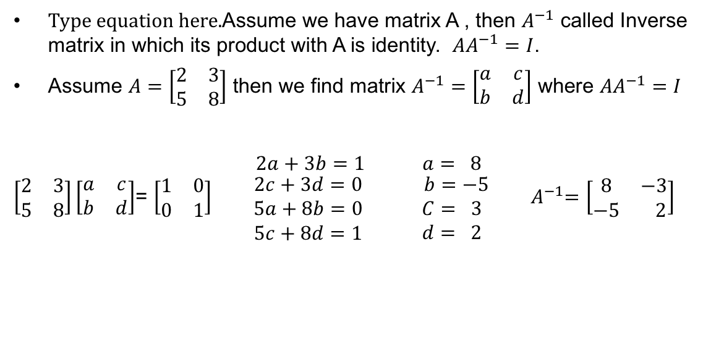
Matrix Inverse
Assume we have matrix A , then $A^{−1}$ called Inverse matrix in which its product with A is identity. $AA^{−1}=I$.
Assume $A=\left[\begin{matrix}2 & 3 \\ 5 & 8\end{matrix}\right]$ then we find matrix $A^{−1}=\left[\begin{matrix}a & c \\ b & d\end{matrix}\right]$ where $AA^{−1}=I$
$\left[\begin{matrix}2 & 3 \\ 5 & 8\end{matrix}\right]\left[\begin{matrix}a & c \\ b & d\end{matrix}\right]$= $\left[\begin{matrix}1 & 0 \\ 0 & 1\end{matrix}\right]\begin{matrix} 2a+3b=1 \\ \begin{matrix} 2c+3d=0 \\ 5a+8b=0 \\ 5c+8d=1\end{matrix}\end{matrix}\begin{matrix} a= 8 \\ \begin{matrix} b=−5 \\ C= 3 \\ d= 2\end{matrix}\end{matrix}$ ${ A}^{−1}=\left[\begin{matrix}8 & −3 \\ −5 & 2\end{matrix}\right]$

Slide 17
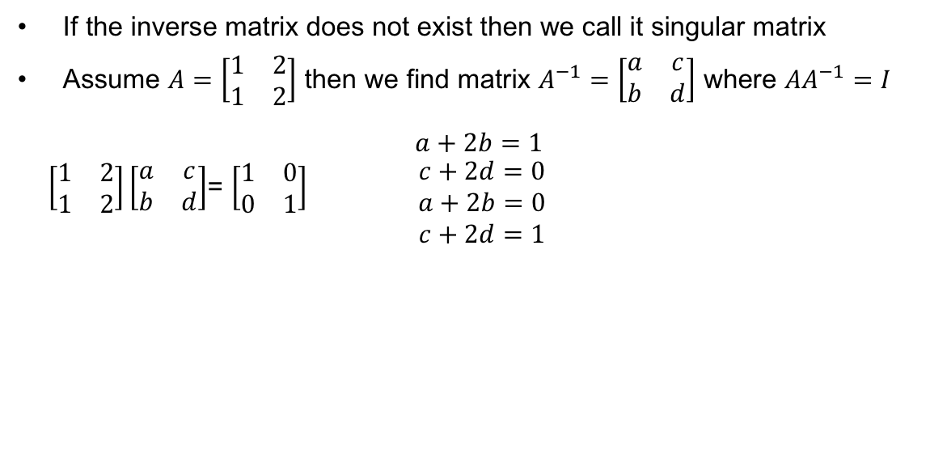
Singular Matrix
If the inverse matrix does not exist then we call it singular matrix
Assume $A=\left[\begin{matrix}1 & 2 \\ 1 & 2\end{matrix}\right]$ then we find matrix $A^{−1}=\left[\begin{matrix}a & c \\ b & d\end{matrix}\right]$ where $AA^{−1}=I$
$\left[\begin{matrix}1 & 2 \\ 1 & 2\end{matrix}\right]\left[\begin{matrix}a & c \\ b & d\end{matrix}\right]$= $\left[\begin{matrix}1 & 0 \\ 0 & 1\end{matrix}\right]\begin{matrix} a+2b=1 \\ \begin{matrix}c+2d=0 \\ a+2b=0 \\ c+2d=1\end{matrix}\end{matrix}$
No Answer
A is a singular matrix

Slide 18
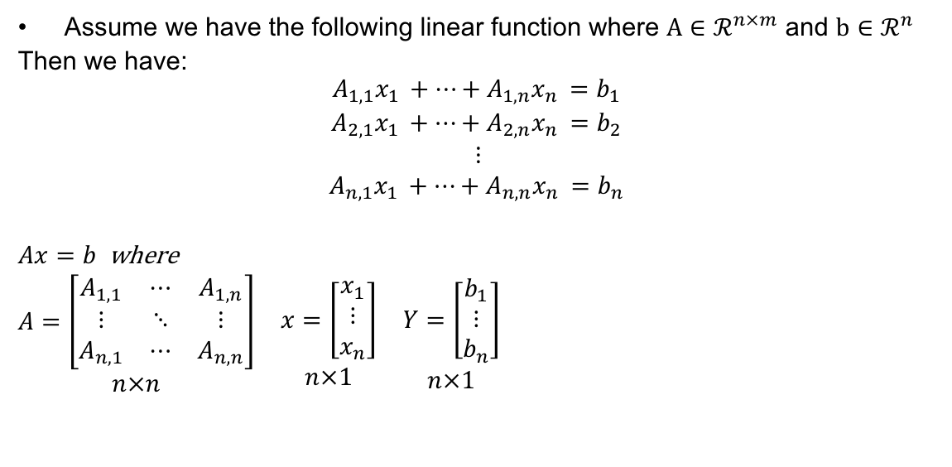
Linear function
Assume we have the following linear function where $A∈ℛ^{n×m}$ and $b∈ℛ^{n}$
Then we have:
$$\begin{matrix}A_{1,1}x_{1 }+⋯+A_{1,n}x_{n }=b_{1 } \\ A_{2,1}x_{1 }+⋯+A_{2,n}x_{n }=b_{2 } \\ \begin{aligned}⋮ \\ A_{n,1}x_{1 }+⋯+A_{n,n}x_{n }=b_{n }\end{aligned}\end{matrix}$$
$Ax=b$ where
$$\begin{matrix}\begin{aligned}A=\left[\begin{matrix}A_{1,1} & ⋯ & A_{1,n} \\ ⋮ & ⋱ & ⋮ \\ A_{n,1} & ⋯ & A_{n,n}\end{matrix}\right] \\ n×n\end{aligned} & \begin{aligned}x=\left[\begin{matrix}x_{1} \\ ⋮ \\ x_{n}\end{matrix}\right] \\ n×1\end{aligned} & \begin{aligned}Y=\left[\begin{matrix}b_{1} \\ ⋮ \\ b_{n}\end{matrix}\right] \\ n×1\end{aligned}\end{matrix}$$

Slide 19
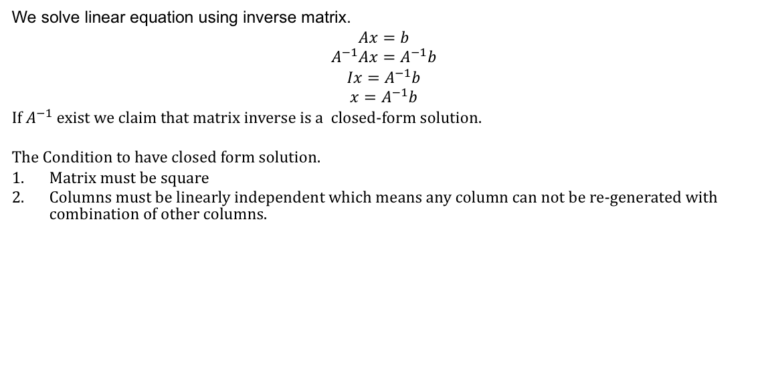
Linear function
We solve linear equation using inverse matrix.
$$Ax=b$$
$$A^{−1}Ax=A^{−1}b$$
$$Ix=A^{−1}b$$
$$x=A^{−1}b$$
If $A^{−1}$ exist we claim that matrix inverse is a closed-form solution.
The Condition to have closed form solution.
Matrix must be square
Columns must be linearly independent which means any column can not be re-generated with combination of other columns.

Slide 20
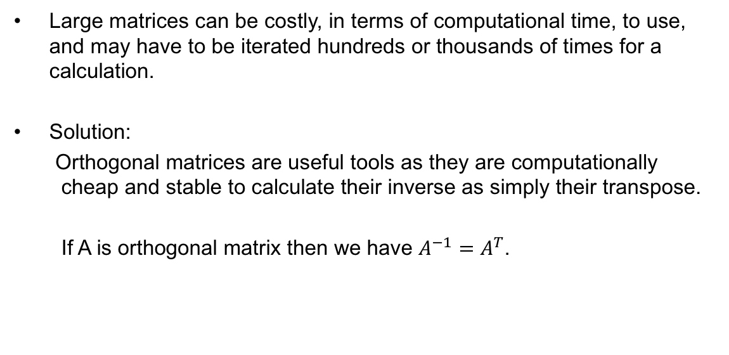
Problem
Large matrices can be costly, in terms of computational time, to use, and may have to be iterated hundreds or thousands of times for a calculation.
Solution:
Orthogonal matrices are useful tools as they are computationally cheap and stable to calculate their inverse as simply their transpose.
If A is orthogonal matrix then we have $A^{−1}=A^{T}$.

Slide 21


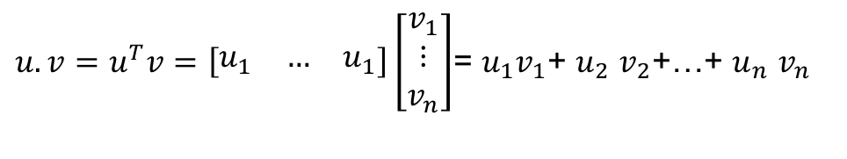
Inner product/Orthogonality
Inner product give us information about the length and the distance between two vectors.
$u.v=u^{T}v=\left[\begin{matrix}u_{1} & … & u_{1}\end{matrix}\right]\left[\begin{matrix}v_{1} \\ ⋮ \\ v_{n}\end{matrix}\right]$= $u_{1}v_{1}$+ $u_{2}$ $v_{2}$+…+ $u_{n}$ $v_{n}$
u
u
u.v=0
u
u.v<0
u.v>0
$$θ$$
$$θ$$
$$θ$$
u.v
v
v
v

Slide 22
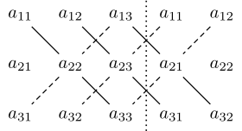
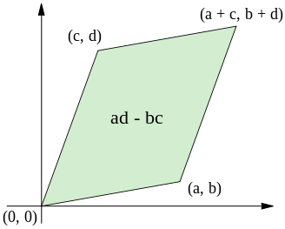
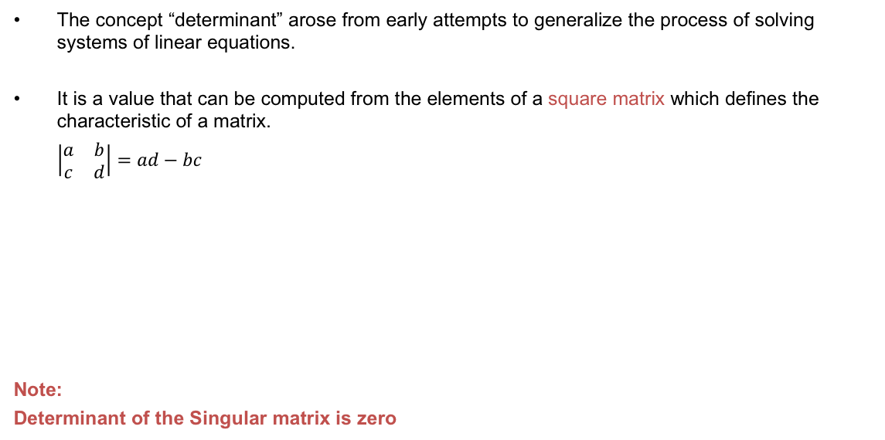
Determinant
The concept “determinant” arose from early attempts to generalize the process of solving systems of linear equations.
It is a value that can be computed from the elements of a square matrix which defines the characteristic of a matrix.
$\left|\begin{matrix}a & b \\ c & d\end{matrix}\right|=ad−bc$
Note:
Determinant of the Singular matrix is zero

Slide 23
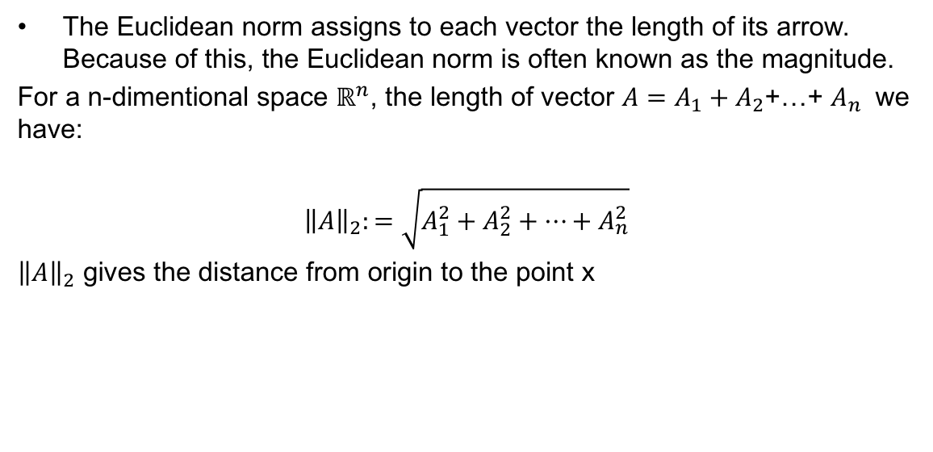
Norm
The Euclidean norm assigns to each vector the length of its arrow. Because of this, the Euclidean norm is often known as the magnitude.
For a n-dimentional space $ℝ^{n}$, the length of vector $A=A_{1}+A_{2}$+…+ $A_{n}$ we have:
$${\left\|A\right\|}_{2}:=\sqrt{A_{1}^{2}+A_{2}^{2}+…+A_{n}^{2}}$$
${\left\|A\right\|}_{2}$ gives the distance from origin to the point x

Slide 24
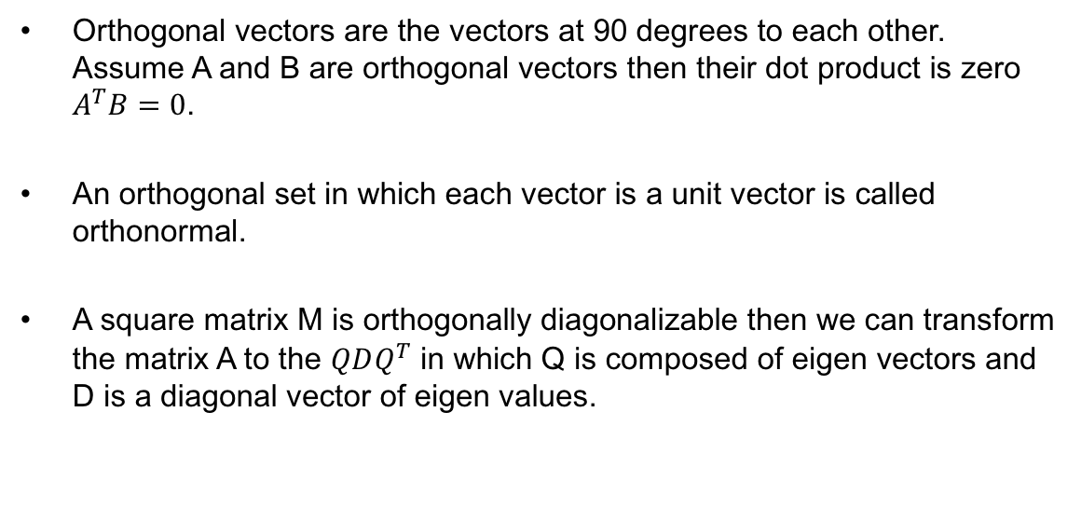
Orthogonal Matrix/Vectors
Orthogonal vectors are the vectors at 90 degrees to each other. Assume A and B are orthogonal vectors then their dot product is zero $A^{T}B=0$.
An orthogonal set in which each vector is a unit vector is called orthonormal.
A square matrix M is orthogonally diagonalizable then we can transform the matrix A to the $QDQ^{T}$ in which Q is composed of eigen vectors and D is a diagonal vector of eigen values.

Slide 25
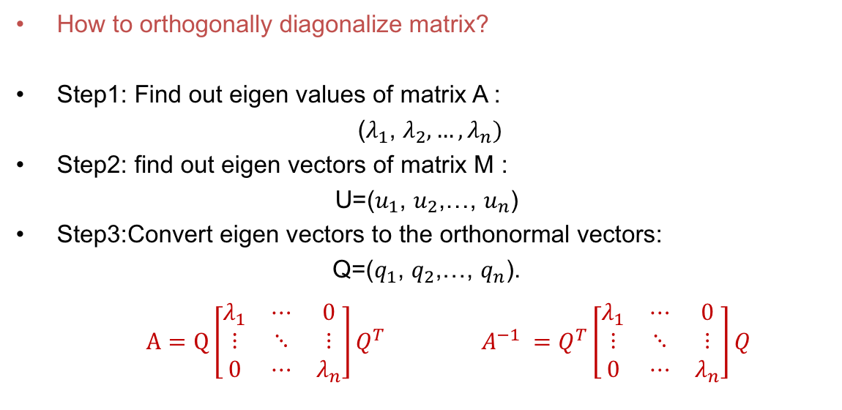
Matrix Diagonalizing
How to orthogonally diagonalize matrix?
Step1: Find out eigen values of matrix A :
($λ_{1}$, $λ_{2},…,λ_{n})$
Step2: find out eigen vectors of matrix M :
U=($u_{1}$, $u_{2}$,…, $u_{n}$)
Step3:Convert eigen vectors to the orthonormal vectors:
Q=($q_{1}$, $q_{2}$,…, $q_{n}$).
$A=Q\left[\begin{matrix}λ_{1} & ⋯ & 0 \\ ⋮ & ⋱ & ⋮ \\ 0 & ⋯ & λ_{n}\end{matrix}\right]Q^{T}$ $A^{−1} =Q^{T}\left[\begin{matrix}λ_{1} & ⋯ & 0 \\ ⋮ & ⋱ & ⋮ \\ 0 & ⋯ & λ_{n}\end{matrix}\right]Q$

Slide 26
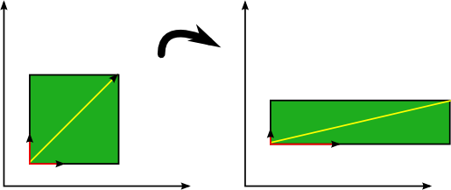

Eigen vector/Eigen value definition
The Eigen values of the vector $v$ can be written as below:
$$Av=λv$$
Here $v$ is called eigen vector and $λ$ is eigen value.
Geometrically the operator A expands when ($λ$>1) or contract ($λ$<1) eigenvectors, but does not rotate them.

Slide 27
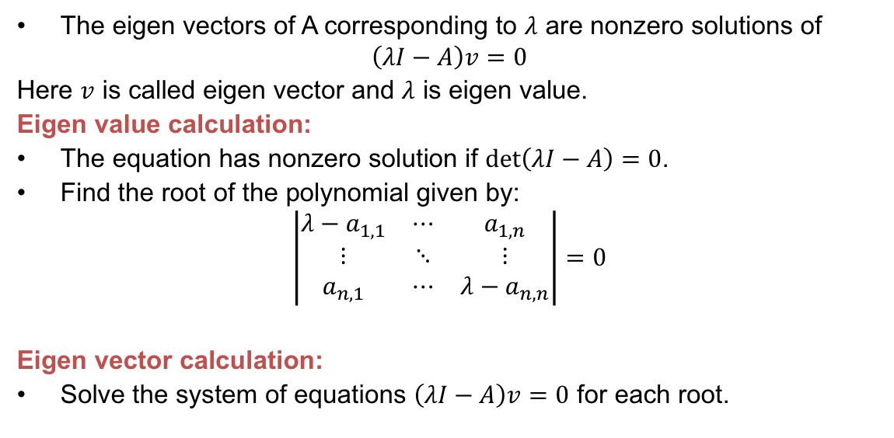
Eigen vector/Eigen value definition
The eigen vectors of A corresponding to $λ$ are nonzero solutions of
$$\left(λI−A\right)v=0$$
Here $v$ is called eigen vector and $λ$ is eigen value.
Eigen value calculation:
The equation has nonzero solution if $det\left(λI−A\right)=0$.
Find the root of the polynomial given by:
$$\left|\begin{matrix}λ−a_{1,1} & ⋯ & a_{1,n} \\ ⋮ & ⋱ & ⋮ \\ a_{n,1} & ⋯ & λ−a_{n,n}\end{matrix}\right|=0$$
Eigen vector calculation:
Solve the system of equations $\left(λI−A\right)v=0$ for each root.

Slide 28
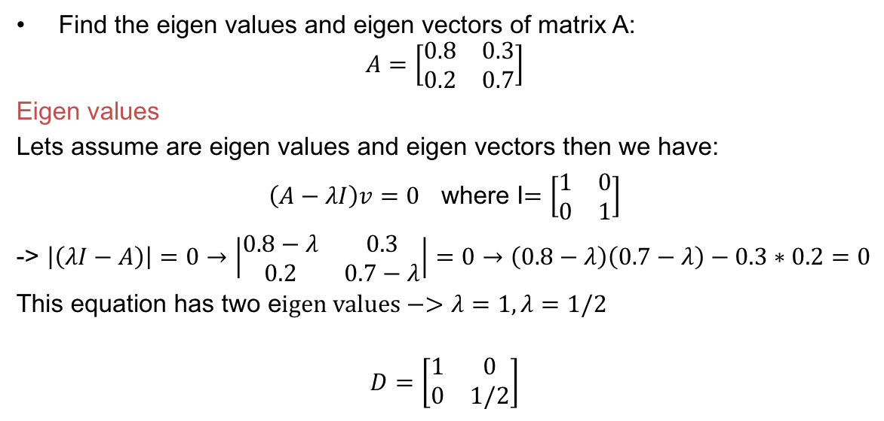
Eigen vector/Eigen value definition
Find the eigen values and eigen vectors of matrix A:
$$A=\left[\begin{matrix}0.8 & 0.3 \\ 0.2 & 0.7\end{matrix}\right]$$
Eigen values
Lets assume are eigen values and eigen vectors then we have:
$\left(A−λI\right)v=0$ where I$=\left[\begin{matrix}1 & 0 \\ 0 & 1\end{matrix}\right]$
-> $\left|\left(λI−A\right)\right|=0→\left|\begin{matrix}0.8−λ & 0.3 \\ 0.2 & 0.7−λ\end{matrix}\right|=0→\left(0.8−λ\right)\left(0.7−λ\right)−0.3∗0.2=0$
This equation has two e$igen values−>λ=1,λ=1/2$
$$D=\left[\begin{matrix}1 & 0 \\ 0 & 1/2\end{matrix}\right]$$

Slide 29

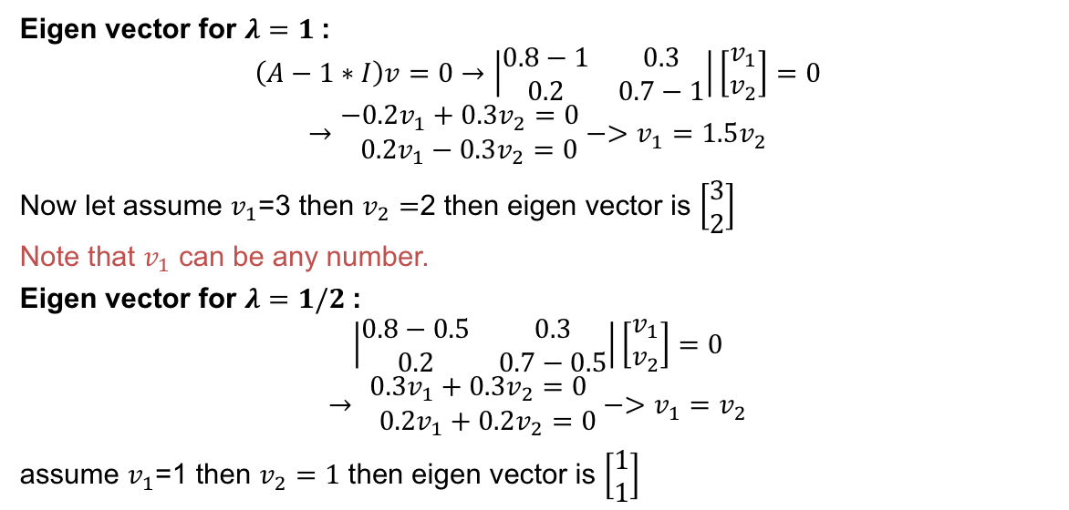
Eigen vector/Eigen value definition
Eigen vector for $λ=1$:
$$\left(A−1∗I\right)v=0→\left|\begin{matrix}0.8−1 & 0.3 \\ 0.2 & 0.7−1\end{matrix}\right|\left[\begin{matrix}v_{1} \\ v_{2}\end{matrix}\right]=0$$
$$→\begin{matrix}−0.2v_{1}+0.3v_{2}=0 \\ 0.2v_{1}−0.3v_{2}=0\end{matrix}−>v_{1}=1.5v_{2}$$
Now let assume $v_{1}$=3 then $v_{2}=$2 then eigen vector is $\left[\begin{matrix}3 \\ 2\end{matrix}\right]$
Note that $v_{1}$ can be any number.
Eigen vector for $λ=1/2$:
$$\left|\begin{matrix}0.8−0.5 & 0.3 \\ 0.2 & 0.7−0.5\end{matrix}\right|\left[\begin{matrix}v_{1} \\ v_{2}\end{matrix}\right]=0$$
$$→\begin{matrix}0.3v_{1}+0.3v_{2}=0 \\ 0.2v_{1}+0.2v_{2}=0\end{matrix}−>v_{1}=v_{2}$$
assume $v_{1}$=1 then $v_{2}=1$ then eigen vector is $\left[\begin{matrix}1 \\ 1\end{matrix}\right]$
$U=\left[\begin{matrix}3 & 1 \\ 2 & 1\end{matrix}\right]$ where u is one of the eigen vector matrices

Slide 30
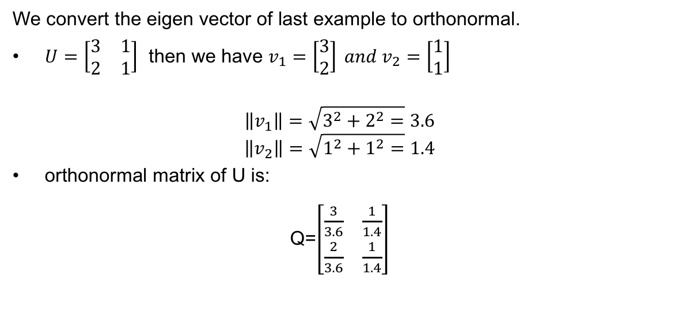
Orthogonal to orthonormal
We convert the eigen vector of last example to orthonormal.
$U=\left[\begin{matrix}3 & 1 \\ 2 & 1\end{matrix}\right]$ then we have $v_{1}=\left[\begin{matrix}3 \\ 2\end{matrix}\right] and{ v}_{2}=\left[\begin{matrix}1 \\ 1\end{matrix}\right]$
$$\left\|v_{1}\right\|=\sqrt{3^{2}+2^{2}=}3.6$$
$$\left\|v_{2}\right\|=\sqrt{1^{2}+1^{2}=}1.4$$
orthonormal matrix of U is:
Q=$\left[\begin{matrix}\frac{3}{3.6} & \frac{1}{1.4} \\ \frac{2}{3.6} & \frac{1}{1.4}\end{matrix}\right]$

Slide 31
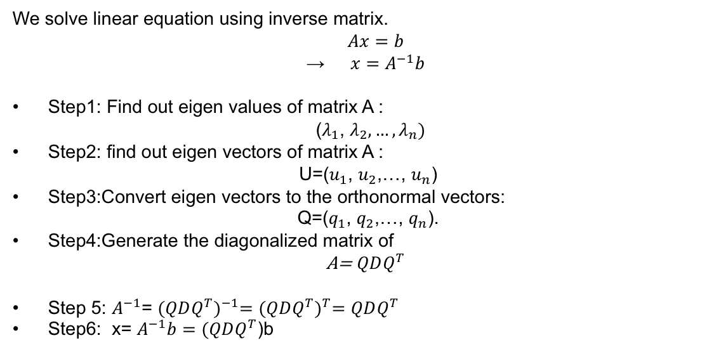
Summary
We solve linear equation using inverse matrix.
$$Ax=b$$
→ $x=A^{−1}b$
Step1: Find out eigen values of matrix A :
($λ_{1}$, $λ_{2},…,λ_{n})$
Step2: find out eigen vectors of matrix A :
U=($u_{1}$, $u_{2}$,…, $u_{n}$)
Step3:Convert eigen vectors to the orthonormal vectors:
Q=($q_{1}$, $q_{2}$,…, $q_{n}$).
Step4:Generate the diagonalized matrix of
A= $QDQ^{T}$
Step 5: $A^{−1}$= ${(QDQ^{T})}^{−1}={(QDQ^{T})}^{T}=QDQ^{T}$
Step6: x= $A^{−1}b=(QDQ^{T}$)b

